Slide 1


Unintentional Injury Prevention
United States Perspective
Grant Baldwin, PhD, MPH
Division of Unintentional Injury Prevention
February 22, 2017

Slide 2
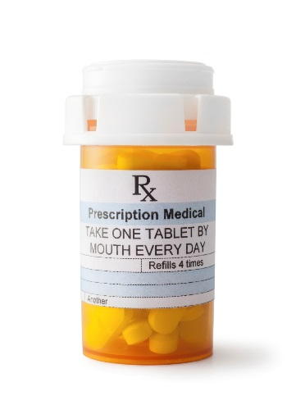



Motor Vehicle Injury
Four Priority Injury Topics at CDC
Prescription Drugs
Older Adult Falls
Traumatic Brain Injury

Slide 3

Prescription Drug Overdose
Prevention

Slide 4




Pillars of CDC Activity
Improve data quality and track trends
Strengthen state efforts by scaling up effective public health interventions
Supply healthcare providers with resources to improve patient safety

Slide 5
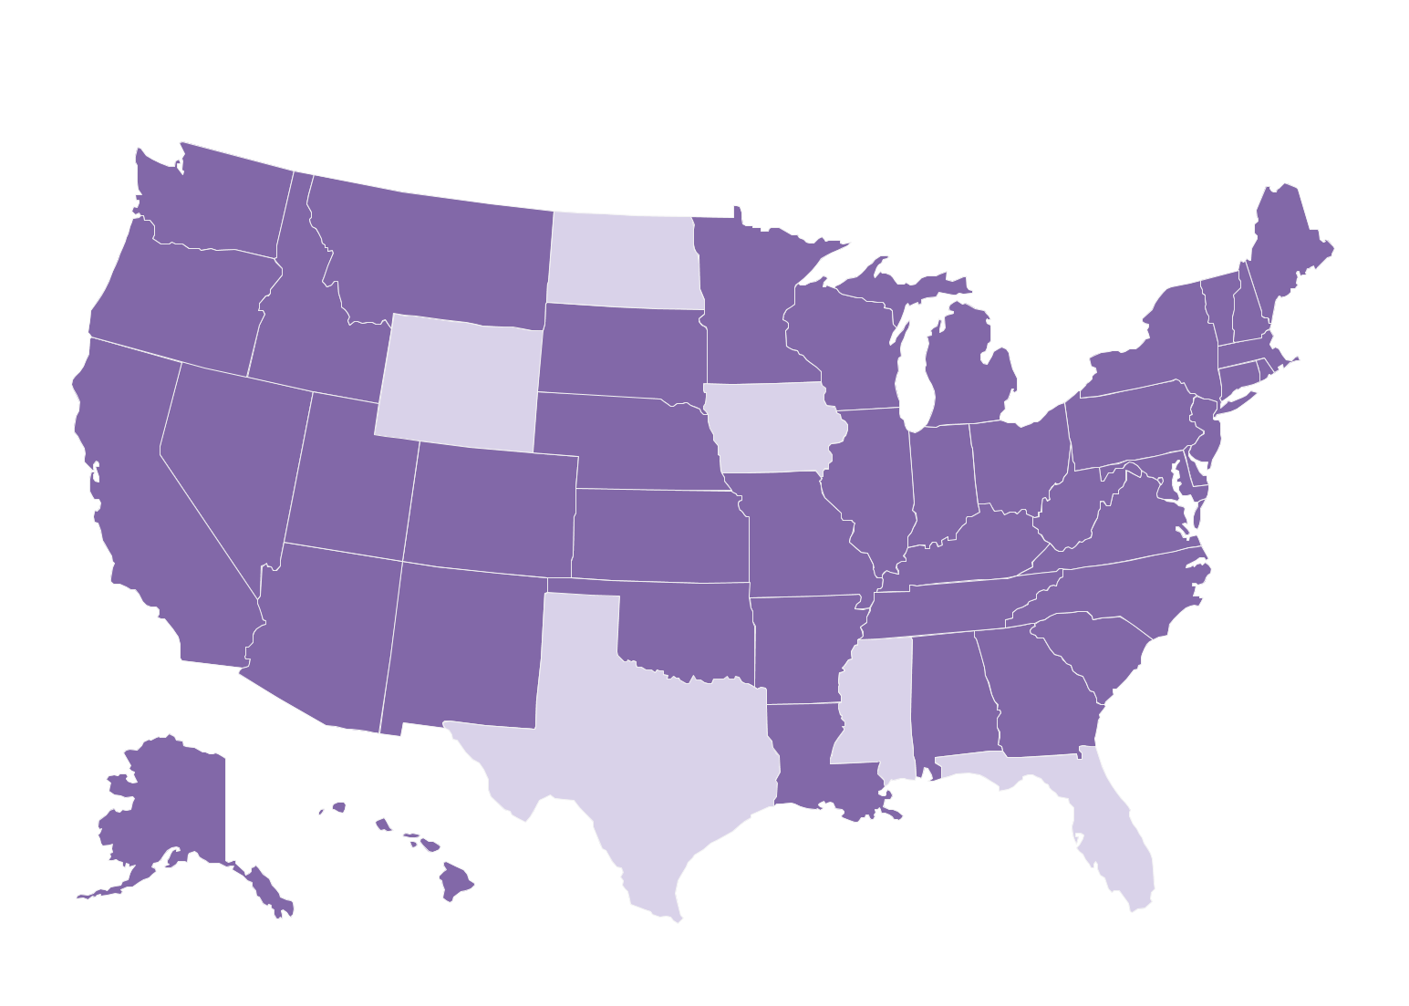





CDC Overdose Prevention in States Initiative
Funded State
Unfunded State
Five Components
PDMPs
System-Level
Evaluate Policy
Surveillance
Rapid Response

Slide 6
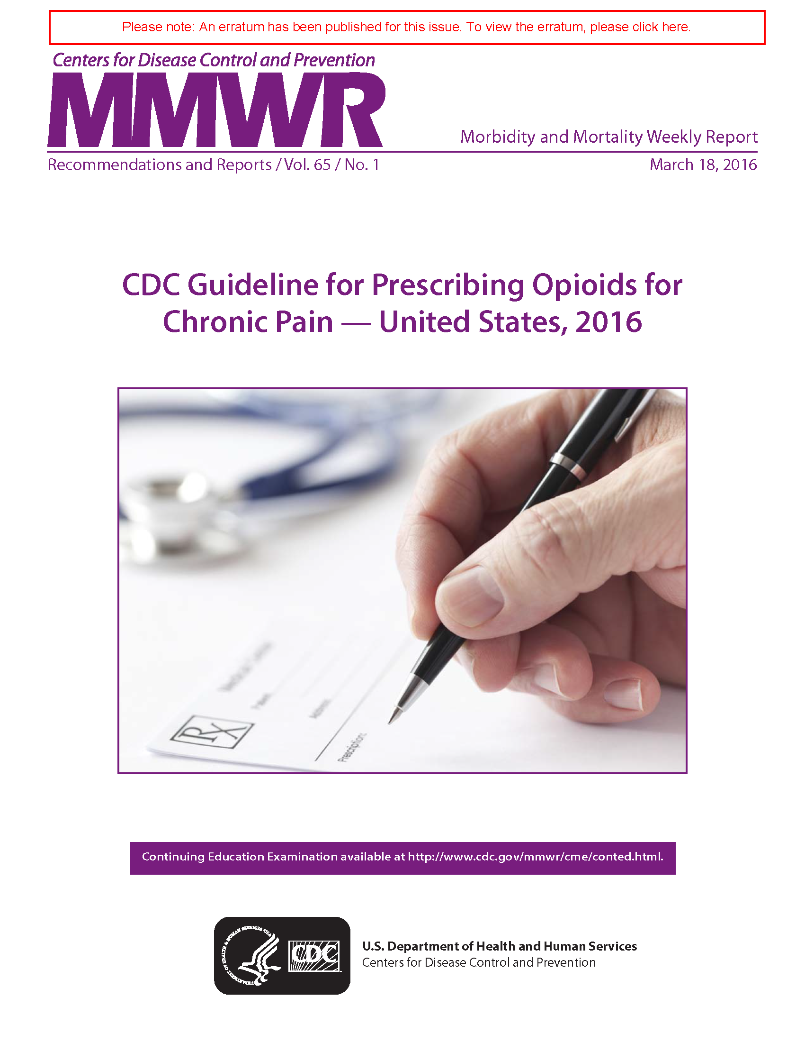
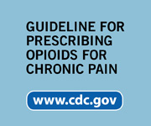

Slide 7






CDC Guideline Implementation
Focus on four priority areas to maximize the uptake and use of the opioid prescribing guideline for chronic pain outside of active cancer, palliative, & end-of-life care
Translation and Communication
Develop tools and resources about the guidelines for a variety of audiences – including providers, health systems, and the general public.
1
2
Clinical Training
Educate providers through medical schools and ongoing continuing medical education (CME) activities.
Health System Implementation
Educate providers, integrate into EHRs and other clinical decision support tools, adopt and use quality metrics, and leverage within broader coordinated care activities.
3
Insurer/Pharmacy Benefit Manager Implementation
Proactive use of claims information and improvement in coverage and service delivery payment models – including reimbursement for clinician counseling; coverage for non-pharmacological treatments; and drug utilization review or prior authorization.
4

Slide 8

Older Adult
Fall Prevention

Slide 9


STEADI: Stopping, Elderly Accidents, Deaths and Injuries

Slide 10

STEADI Implementation
Focus on four priority areas to making fall prevention a routine part of clinical care
Health System Implementation
Develop EHR and other clinical decision support tool integration, prevent fall-related hospital readmissions, promote team-based care, link to community-based programs
1
Billing, Reimbursement, and Provider Incentives
Develop CPT Category 1 Codes, generate CMS Quality Measures and incentive programs, support USPSTF recommendations
2
3
Training and Education
Educate providers through various continuing medical education activities (CME) and the provision of educational tools and resources
Translation and Communication
Conduct research on the burden of falls and effective interventions, develop tools & resources for a variety of audiences – including providers, health systems, and the public
4

Slide 11



Integrating STEADI into
Electronic Health Records
Oregon Health & Science Univ
Epic’s Clinical Program for STEADI
University of Oklahoma
STEADI module
Medication management module

Slide 12
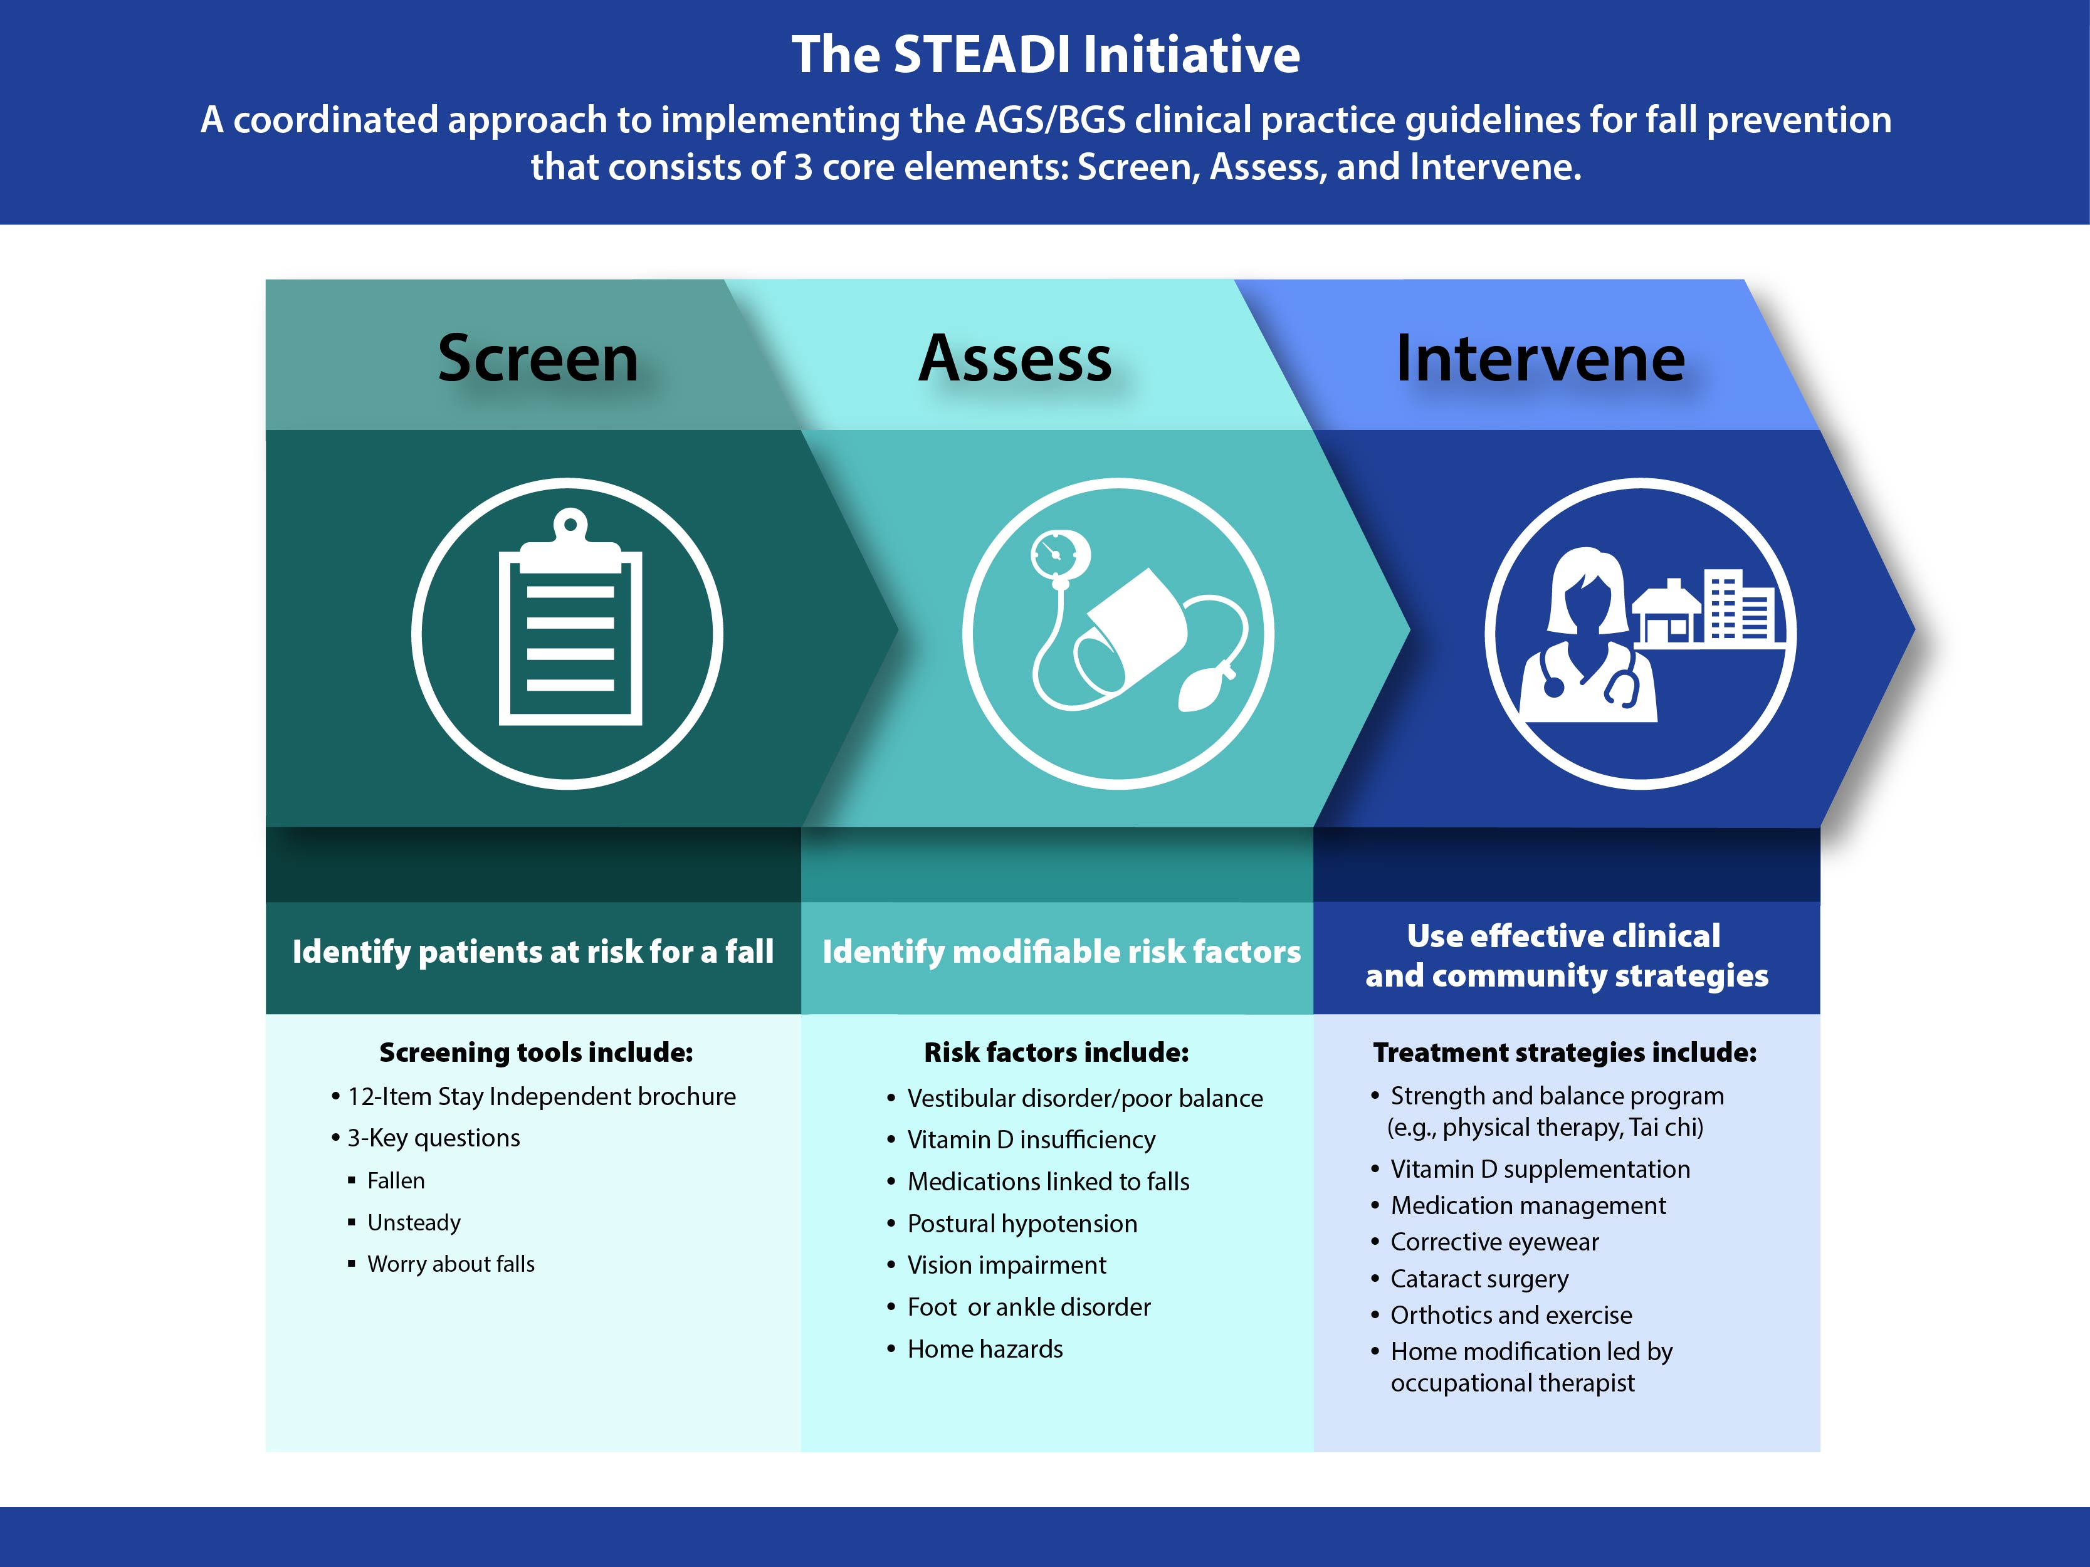
STEADI connects. . .

Slide 13

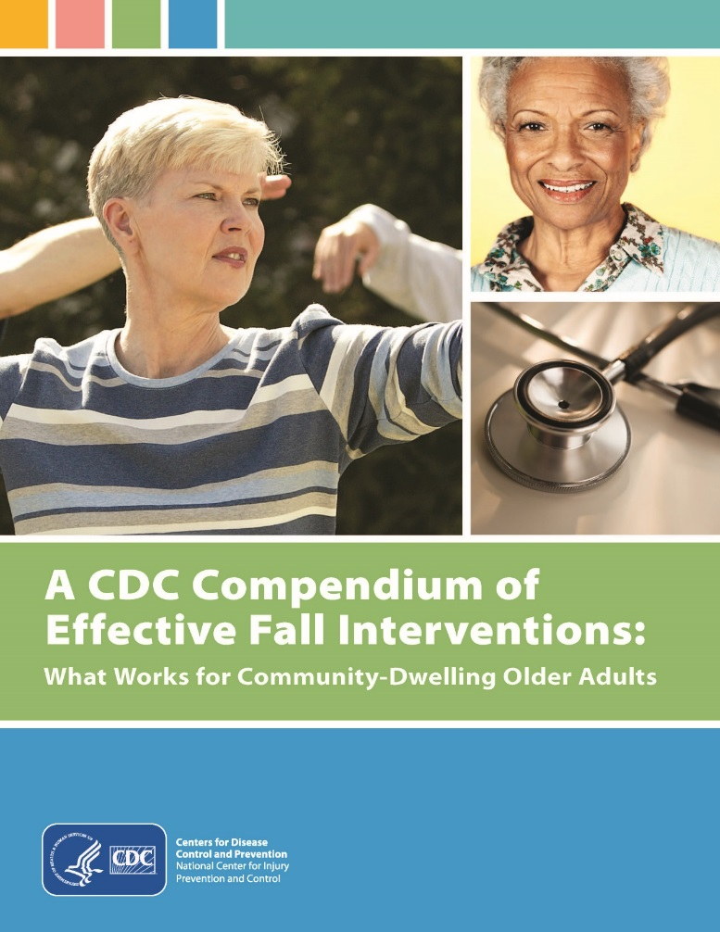

Making it easier to implement effective community-based fall prevention programs
+

Slide 14
Trainings that Target Multiple Audiences
Steps to save lives and save costs
1
SCREEN for fall risk
REVIEW and manage medications linked to falls
RECOMMEND daily vitamin D supplements
Getting Started
2
3
Insights from current users

Slide 15

Motor Vehicle Injury Prevention

Slide 16






Motor Vehicle Injury Prevention Priority Areas
Restraints
Tribes
Impaired Driving
Older Adult Mobility
Data Linkage

Slide 17






Road to Zero

Slide 18
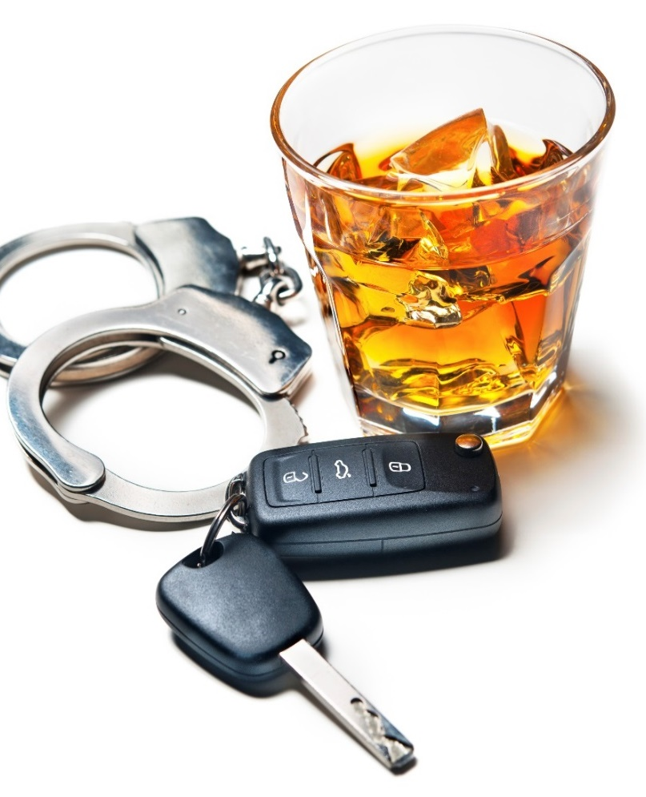
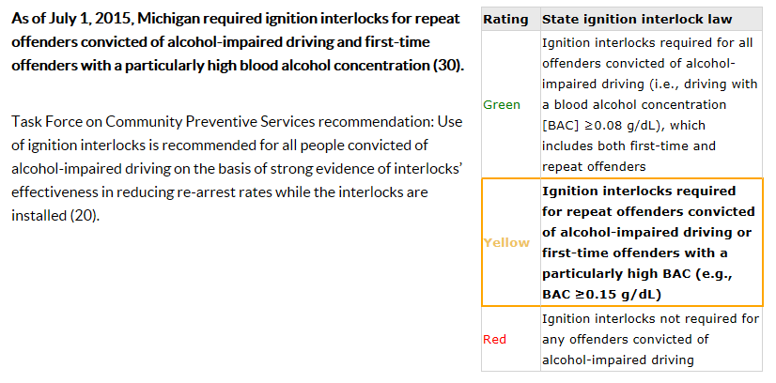
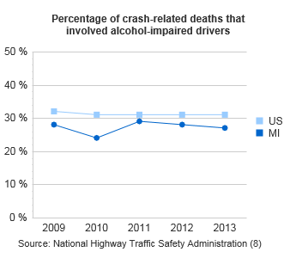
Benchmarking Progress
Michigan
PSR | 2015

Slide 19


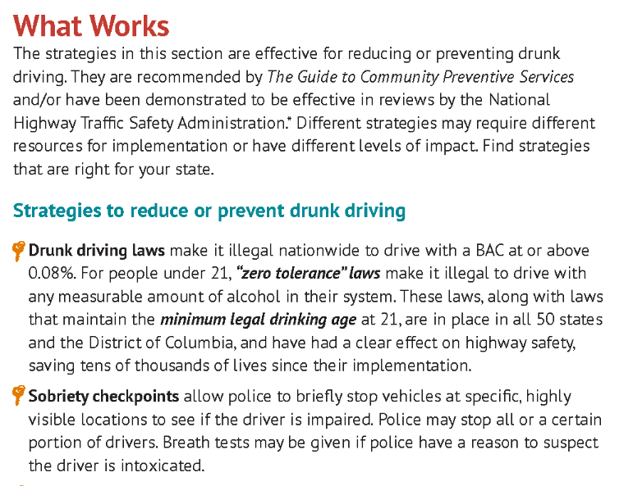

Focus on what works and your best buys for lives saved and cost in every state
State-Based Fact Sheets
Cost Calculator
Motor Vehicle Prioritizing Interventions and Cost Calculator for States
http://www.cdc.gov/motorvehiclesafety/

Slide 20



Linking Data for a Comprehensive Understanding of Crashes
.
http://www.cdc.gov/motorvehiclesafety/linkage

Slide 21

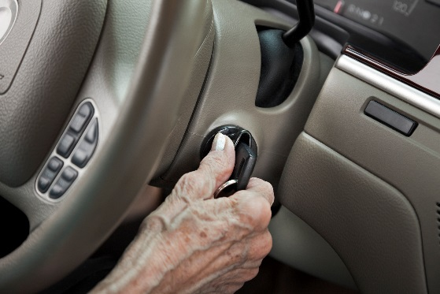

Myself – A PLAN TO KEEP ME HEALTHY
My House – A PLAN TO KEEP ME SAFE INSIDE MY HOME
My Community –A PLAN TO STAY MOBILE IN MY COMMUNITY
Mobility-related deaths are the leading cause of injury death for adults aged 65 years and above
Mobility Planning Tool
Targets adults age 60-74
Plan for mobility changes as you age in the same way that you may plan financially for retirement
Leverages broad array of partner resources

Slide 22

Traumatic Brain Injury

Slide 23

TBI Pillars for CDC Activities
Improving the understanding of the public health burden of TBI
Reducing the incidence of TBI through primary prevention
Improving the recognition and management of mild TBI
Improving health outcomes of persons living with TBI

Slide 24

Proposed National Concussion
Surveillance System
Unmatched detail on concussion in America
Prevention
Have you had a head or neck injury in the past 12 months?
How did your injury occur?
All Ages
All Mechanisms of Injury
Medical Services Received
Return to Learn, Play, and Work
TBI Disability
Lifetime Prevalence
Care
Where did you seek care after you experienced this injury?
What types of symptoms did you have?
Recovery
Do you still experience the effects from the injury?
How long did it take to go back to work or school?

Slide 25



Pediatric Mild TBI Guidelines
Importance of appropriate diagnosis of children and teens with mild TBI.
Need for evidence-based guidelines to help U.S. clinicians treating children and teens.
Workgroup established with over 40 experts.
6 clinical questions, over 12,000 abstracts and 1,700 full-text articles reviewed.
Expected in 2018.

Slide 26



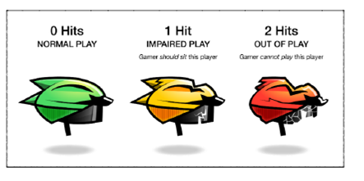
Travel to Galactic City

Slide 27


Surveillance Summary
MARCH 2017
TBI-related Emergency Department Visits, Hospitalizations, and Deaths - 2013

Slide 28


Report to
REPORT TO CONGRESS
The Management of TBI in Children
U.S. Congress
Projected 2017

Slide 29
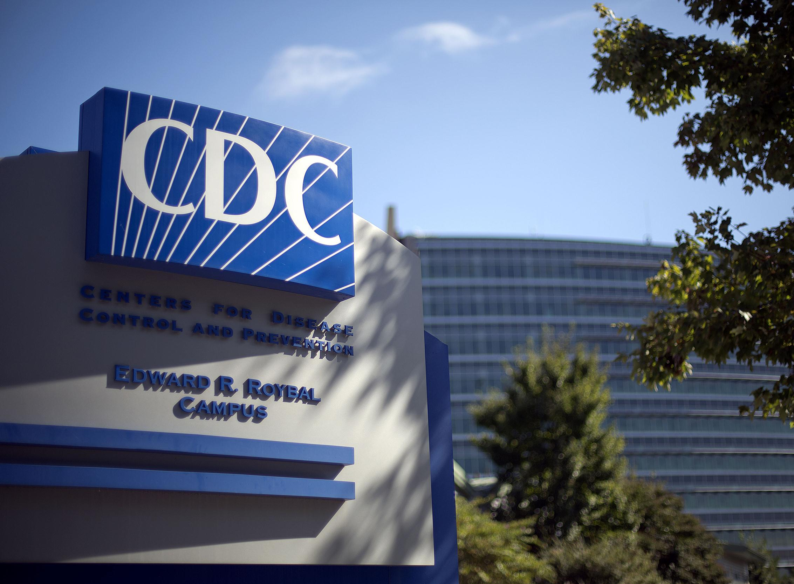
For more information please contact Centers for Disease Control and Prevention
1600 Clifton Road NE, Atlanta, GA 30333
Telephone: 1-800-CDC-INFO (232-4636)/TTY: 1-888-232-6348
E-mail: cdcinfo@cdc.gov Web: www.cdc.gov
The findings and conclusions in this report are those of the authors and do not necessarily represent the official position of the Centers for Disease Control and Prevention.

